Slide 1


TELECOME CUSTOMER CHURN PREDICTION
SmartBridge –Remote Summer Internship program
USING MACHINE LEARNING
Developed By:
Srija Dodda
Ramya Adi
Swetha Bekkanti
Prashanthi Peddireddy

Slide 2
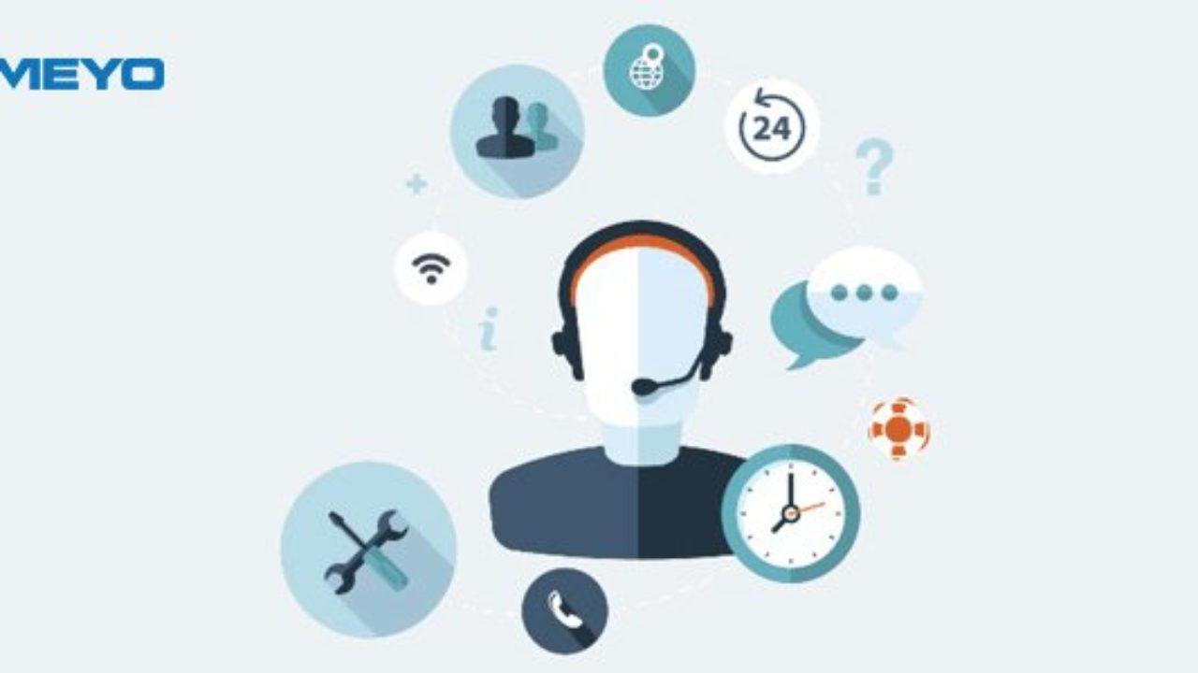
INTRODUCTION
Customer churn is the ratio at which customers stop doing business with the entity
There are many strategies to generate more revenues for the company like acquire new customers,upsell the existing customer and increase the retention period of customers.
However retaining a customer costs much lower than acquiring new customers,so to retain a customer companies have to decrease the potential of customer churn.
Due to the direct effect on the revenues of the companies,especially in the telecom field,companies are seeking to develop means to predict potential customer to churn.
In this scenario,we need a model that predicts the customer who is likely leave the company.So that the company can take necessary measures to retain the customers.
We use random forest algorithm as it gives more accuracy in the result comapre to other methods.
Our,model predicts whether a customer will remain stay or customer will exit.
We require personal data of the customers to predict the churn.

Slide 3
APPLICATIONS
The term customer churn is used to describe the loss of existing customers
Tracking customer churn is a key business metric for most companies.
To have an idea of customer relationship cycle such as customer acquisition, increasing value of the customer and customer retention.
It is widely used for managing risks in the telecom customer industry.
And, armed with accurate,real-time data about the lifetime value of customers company will be in much better position.

Slide 4
FLOWCHART
.
Import Libraries
Dataset Collection
Data preprocessing
Checking Null Values
Feature Scaling
Train And Test Split
Data
OneHotEncoding
Splitting Data
Testing Model
Incorporate with HTML And Flask
Deployment
Getting prediction

Slide 5
ADVANTAGES
It is used in a variety of different industries and types of bussiness.
It is widely used for managing risks in the telecom customer company.
Can easily cope with thousands of users.
Backup,security and account control are all central.
It is composed using the HTML and Python for the web usage in real time.
Random Forest gives the accurate result of the prediction upto 77% which is the algorithm we used for prediction.

Slide 6

DISADVANTAGES
The higher your customer churn rate, the lower the chances of growing the business.
If one of the servers go down all the users are affected and it may even bring the whole network down.
If they are losing customers at a high rate, as the cost of acquiring new customers is so high.
Gives only 77% accuracy for the customer churn status

Slide 7
Churn rate is a health indicator for subscription based companies.The ability to identify customers that aren't happy with provided solutions allows business to learn about product or pricing plan weak points,operation issues, as well as customer preferences and expectations to proactively reduce reasons for churn.
CONCLUSION

Slide 8
THANK YOU
.

